Slide 1





시스템 구성도(협회별관-본부)
AS-IS
192.168.240.0/20
별관
192.168.1.0/24
192.168.2.0/24
192.168.3.0/24
범례:
192.168.11.0/24
본사

Slide 2

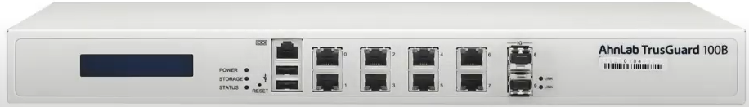


시스템 구성도(협회별관)
AS-IS
220.76.223.98/28
VIP : 220.76.223.97/28
220.76.223.99/28
192.168.11.2/24
VIP : 192.168.11.1
192.168.11.3/24
192.168.11.4/24
192.168.11.5/24

Slide 3



시스템 구성도(협회내부)
AS-IS
Internet
VPN장비
218.154.54.202/32
VIP=218.154.54.193
eth1:218.154.54.195/28
eth3:218.154.54.211/28
eth1:218.154.54.194/28
eth3:218.154.54.210/28
218.154.54.201/32
Eth2 192.168.30.1/24
음악저작권협회 본사(Slave)
TG-400B
전화기서버
펌뱅킹서버
음악저작권협회 본사(Master)
TG-400B
IP=192.168.10.1
VIP=192.168.10.2
IP=192.168.10.3
:192.168.30.2
eth4:192.168.20.1/24
VIP=192.168.1.1
SSL Server
TG-100B
IP=192.168.1.2
L3
L3
IP=192.168.1.3
L2

Slide 4


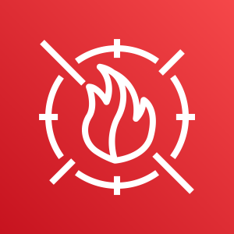






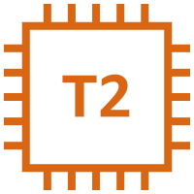













시스템 구성도
AS-IS
NFS 스토리지
VPC 내부
인터넷 통신
음저협 지부
VPC (192.168.240.0/20)
TrusGuard
WAF
Availability Zone-2a
AWS Shield
Public subnet-1 192.168.247.0/24
Pub-pri subnet-1 192.168.241.0/24
Private subnet-1 192.168.242.0/24
Data subnet-1 192.168.243.0/24
Azure
Route53
FTP, 외국음원
NAT(예비)
gateway
Monitoring
WEB1
스팸
RDS (Master)
WAS1
모바일 (KOS-G)
검색엔진
NFS
더존클라우드
그룹웨어,
메일서버
Internet
gateway
ALB
NLB_WEB
NLB_mmail
NLB_SPAM
사용자
음저협 IDC
NAT
gateway
APMA
WEB2
mmail
WAS2
백업서버
음원&디지털
문서보관
Public subnet-2 192.168.248.0/24
Pub-pri subnet-2 192.168.244.0/24
Private subnet-2 192.168.245.0/24
Data subnet-2 192.168.246.0/24
TrusGuard
Availability Zone-2c
CGW
VGW
VPC Endpoint
S3 (=AWS Backup)
Ipsec VPN
connection

Slide 5














kosmos-vpc (192.168.240.0/20)
kosmos.or.kr
Users
KOSMOS 구성도
Public A
Public C
Availability Zone
Corporate Data Center
kosmos-pub-subnet-01 (192.168.241.0/24)
kosmos-pub-subnet-02 (192.168.244.0/24)
Bas
tion
m
mail
VPC subnet
web
01
web
02
KOSMOS 지부
gr
ware
grp
mail
SPAM
Private A
Private C
Route 53
Search
Mobile
NFS
was
01
was
02
Back
up
VPN
Connection
kosmos-pri-subnet-01 (192.168.242.0/24)
kosmos-pri-subnet-02 (192.168.245.0/24)
NAT Gateway
Classic Load Balancer
Public A
Public C
Customer
Gateway
RDS
Amazon S3
VPN Gateway
kosmos-db-subnet-01 (192.168.243.0/24)
kosmos-db-subnet-01 (192.168.246.0/24)
KOSMOS 사내
Users
# Availability A
# Availability C
IAM
Corporate Data Center

